Slide 1




Exception Handling
Handling Errors During the Program Execution
Java
Advanced
SoftUni Team
Technical Trainers
Software University
http://softuni.bg

Slide 2

Table of Contents
What are Exceptions?
Types of Exceptions
Handling Exceptions
Best Practices

Slide 3
Questions
sli.do #8784

Slide 4

What are Exceptions?

Slide 5
What are Exceptions?
The exceptions in Java are a powerful mechanism for centralized handling of errors and unusual events
Simplify code construction and maintenance

Slide 6

Handling Exceptions

Slide 7
The try-catch Statement
The statement:
try {
// Do some work that can cause an exception
} catch {
// This block will execute if any type of exception occurs
}

Slide 8
The try-catch Statement (2)
try {
// Do some work that can cause an exception
} catch(FormatException identifier) {
// This block will execute only if format exception occurs
}

Slide 9
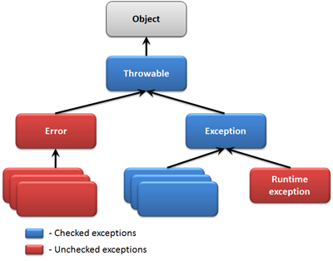
The Hierarchy of Exceptions

Slide 10
The Throwable Class
The java.lang.Throwable class is base for all exceptions in Java
Contains information for the cause of the error / unusual situation
getMessage() – text description of the exception
printStackTrace() – prints the throwable and its backtrace
getStackTrace() – returns an array of StackTraceElement

Slide 11
Exception types
Checked exception
They must be declared in the method or constructor’s throws clause
Unchecked exceptions (RuntimeException)
They do not need to be declared

Slide 12

Exception Properties
Exercises in class

Slide 13
The try-finally Statement
The statement:
Ensures execution of given block in all cases
When exception is raised or not in the try block
Used for execution of cleaning-up code, e.g. releasing resources
try {
// Do some work that can cause an exception
} finally {
// This block will always execute
}

Slide 14
The try-catch-finally Statement
The statement:
try {
// Do some work that can cause an exception
} catch(FileNotFoundException identifier) {
// This block will be executed only if file not found exception occurs
} finally {
// This block will always execute
}

Slide 15
Try-with-resources statement
In programming we often forget to close our resources.
The try-with-resources statement in Java, ensures that resources are always closed properly
try (BufferedReader br = new BufferedReader(new FileReader(path))) {
return br.readLine;
}

Slide 16
Handling Exceptions
Exercises in class

Slide 17

Summary
Exceptions provide a flexible error handling mechanism
Each exception handler processes only errors of a particular type (and its child types)
Other types of errors are processed by some other handlers later
Unhandled exceptions cause error messages

Slide 18








Exception Handling
https://softuni.bg/courses/java-fundamentals

Slide 19
License
This course (slides, examples, demos, videos, homework, etc.) is licensed under the "Creative Commons Attribution-NonCommercial-ShareAlike 4.0 International" license
Attribution: this work may contain portions from
"OOP" course by Telerik Academy under CC-BY-NC-SA license

Slide 20






Free Trainings @ Software University
Software University Foundation – softuni.org
Software University – High-Quality Education, Profession and Job for Software Developers
softuni.bg
Software University @ Facebook
facebook.com/SoftwareUniversity
Software University @ YouTube
youtube.com/SoftwareUniversity
Software University Forums – forum.softuni.bg

